Slide 1
Welcome to Our Software Testing Project
Presented by Our Team:
Lamis ahmed
Seif osama
Ahmed abdelkhalek
Mai khaled
Hana ayman

Slide 2
Introduction
Testing Types: Manual, API, Automation, Database, Performance.
Focus: Validate functionality, reliability, and user experience
Process Covered
-Test Case Design
-Test Execution, Results & Tools

Slide 3
Project Overview - Software Testing on Demo Web Shop
Website Under Test: Demo blaze
Using:
Jira – For task management & tracking bugs
GitHub – For version control and project collaboration
JMeter – For performance testing
Postman – For API testing
SQL – For database queries and validation
Manual & Automated Testing Approaches
CI/CD Integration (Using Jenkins)

Slide 4
Project Overview - Software Testing on Demo Web Shop
Website Under Test: Demo blaze
Steps:
1)Manual Testing(Test Cases)
2)Bugs Reports
3) identified bugs and issues in Jira for tracking and resolution
4)Automation Testing Using Selenium
5)Api Testing Using Postman
6)Database Testing
7)Performance Testing Using Jmeter
8)Integration Using Jenkins

Slide 5
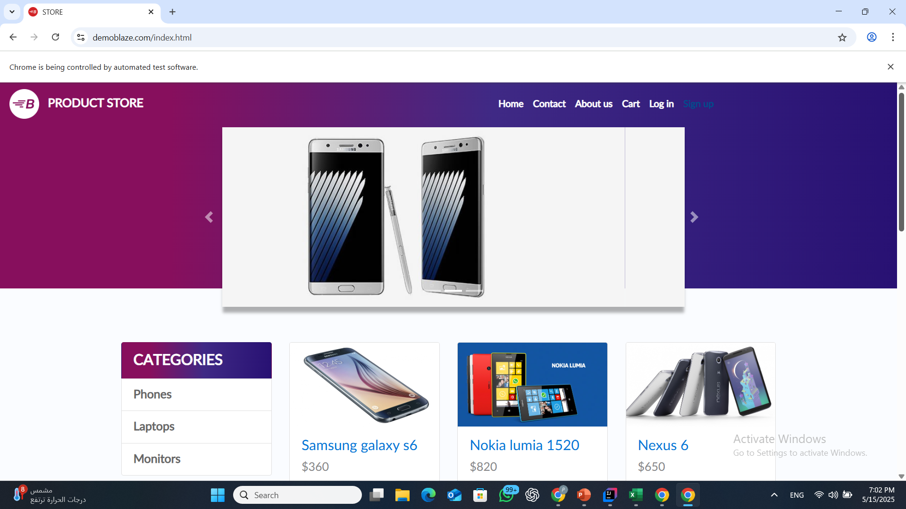

Slide 6
Manual testing
Test cases and bug report generating
Test cases were divided based on modules and test categories

Slide 7
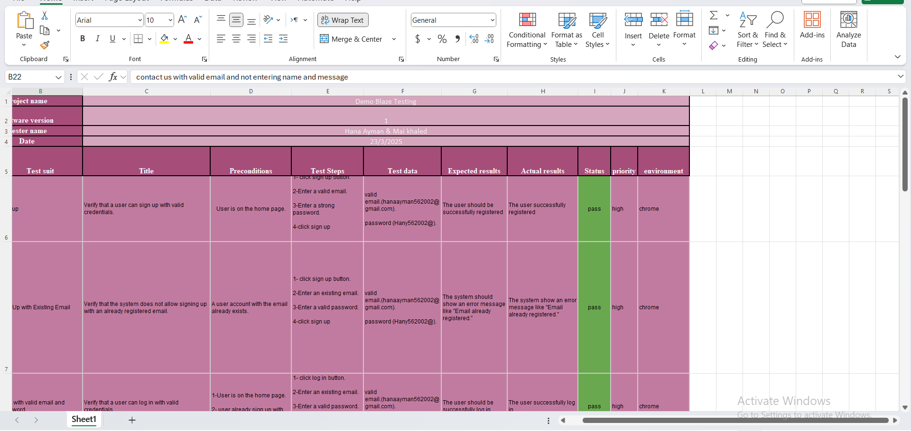
Manual Testing

Slide 8
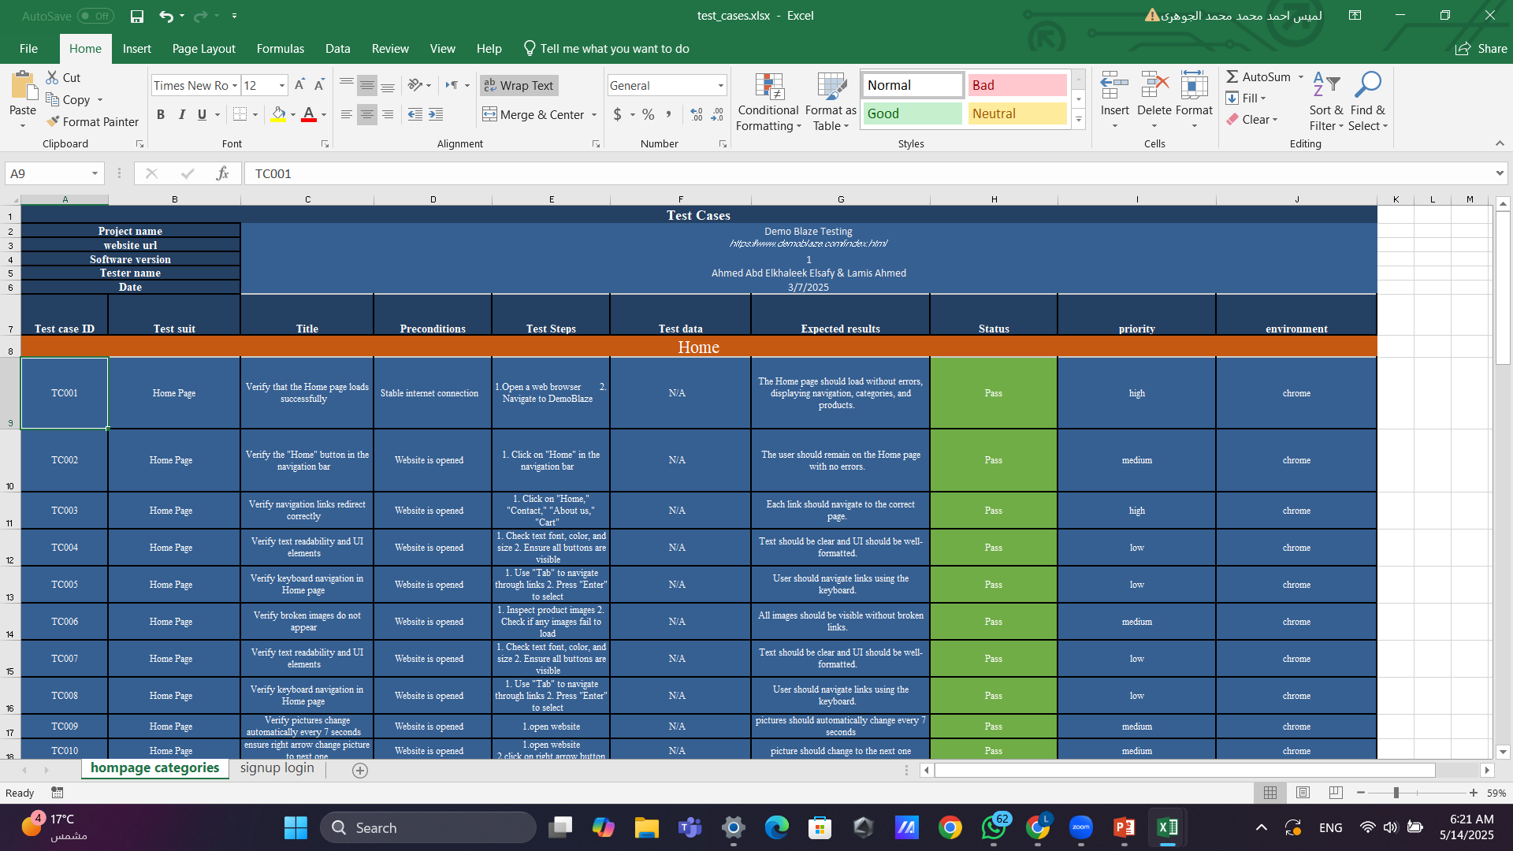

Slide 9
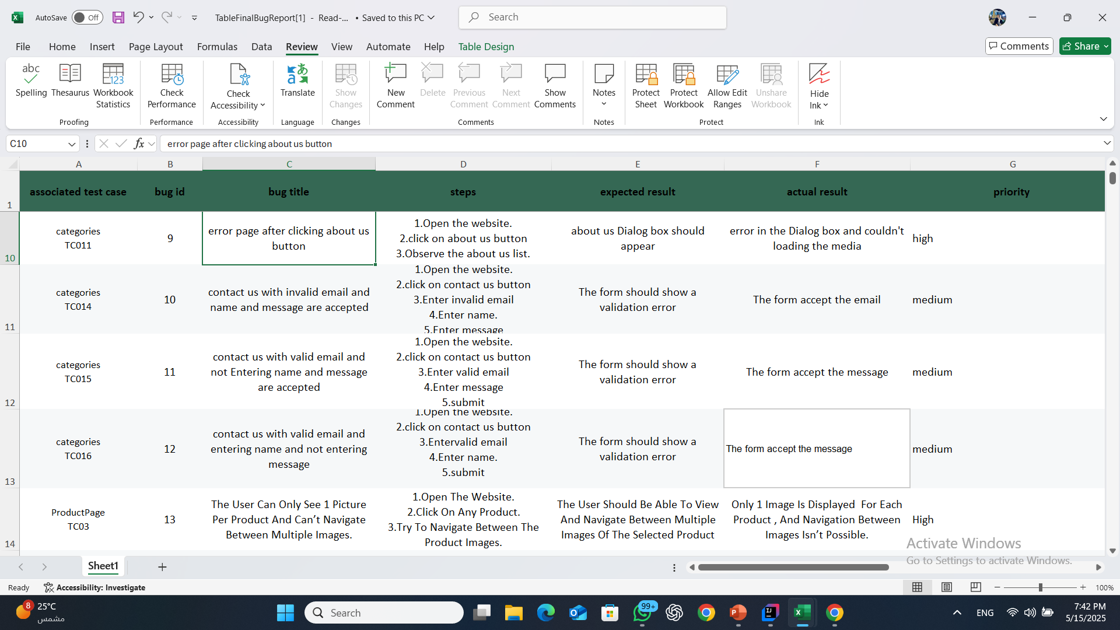
BUGS REPORT

Slide 10
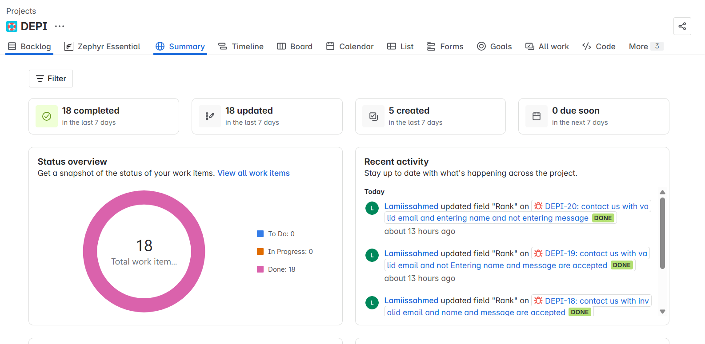
Bug Tracking and Reporting (Using Jira)

Slide 11
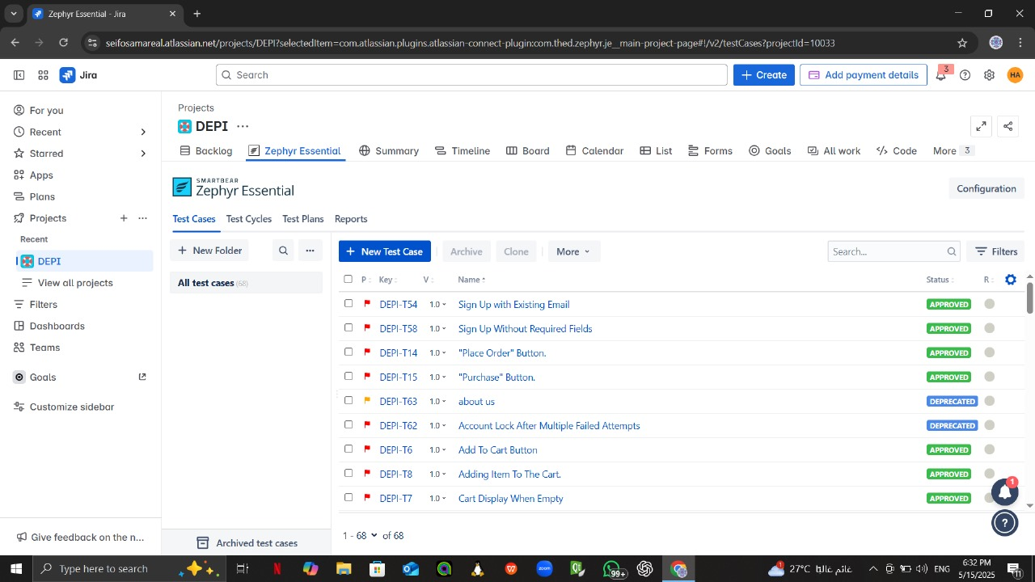

Slide 12
Automation Testing
Automation was essential in the project
Where Automation testing runs tests automatically without manual intervention increasing test efficiency and saving time and effort
Tools used
selenium , TestNg

Slide 13
Maven project
Supports testing tools
CI/CD integration
Easy dependency management

Slide 14
Automation Testing
Problems faced : The program was not waiting long enough for elements to load, causing errors in interaction.
Solutions:
WebDriverWait: Utilized to wait dynamically for elements based on a condition (e.g., visibility of elements)

Slide 15
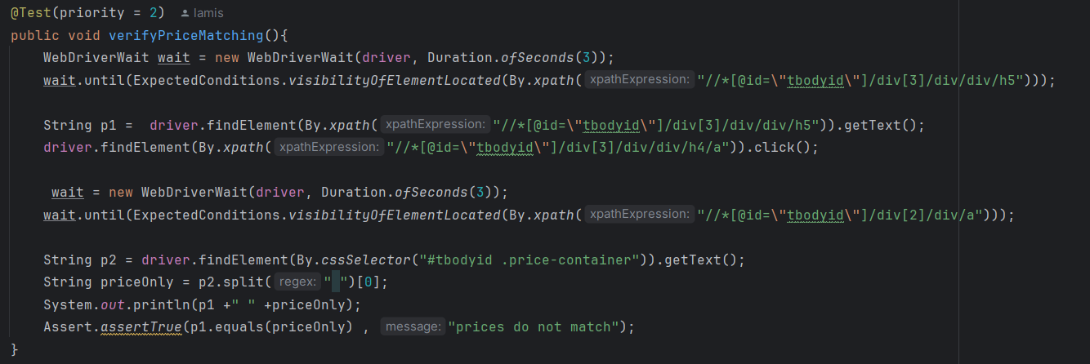
Automation Testing

Slide 16
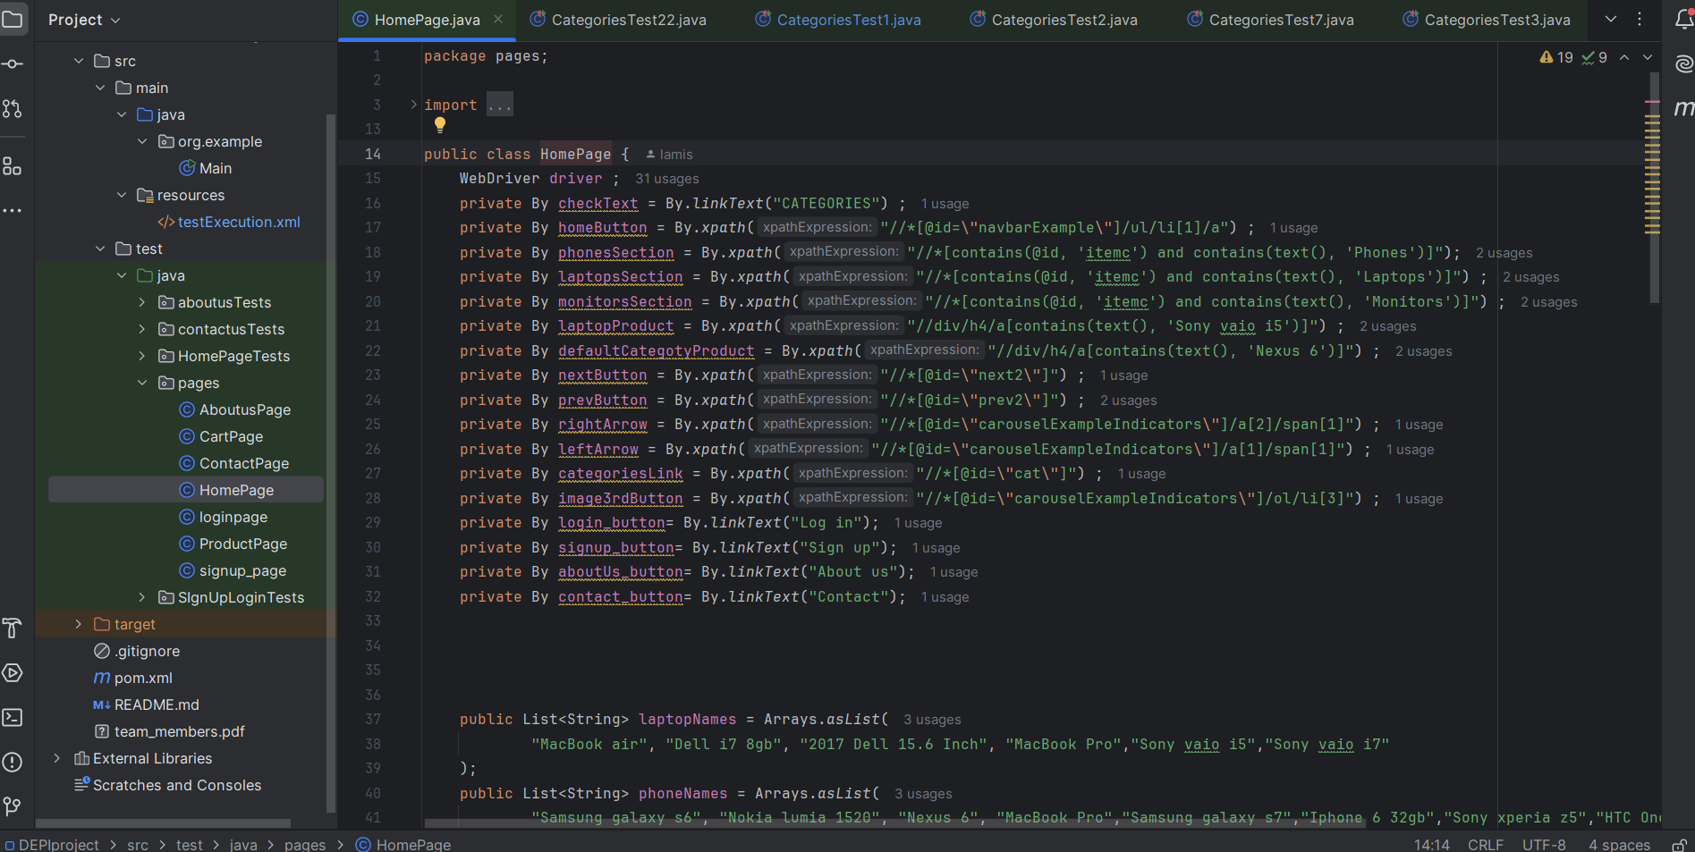
Using pom model

Slide 17
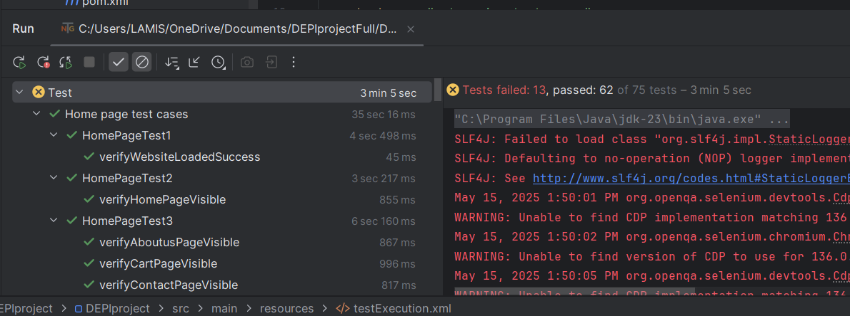
Automation Results

Slide 18
API Testing – Validating Response Codes
Result | Test Case | Method | Endpoint
✅ 200 OK | Valid request | GET | /users/1
❌ 401 Unauthorized | Missing fields | POST | /users

Slide 19
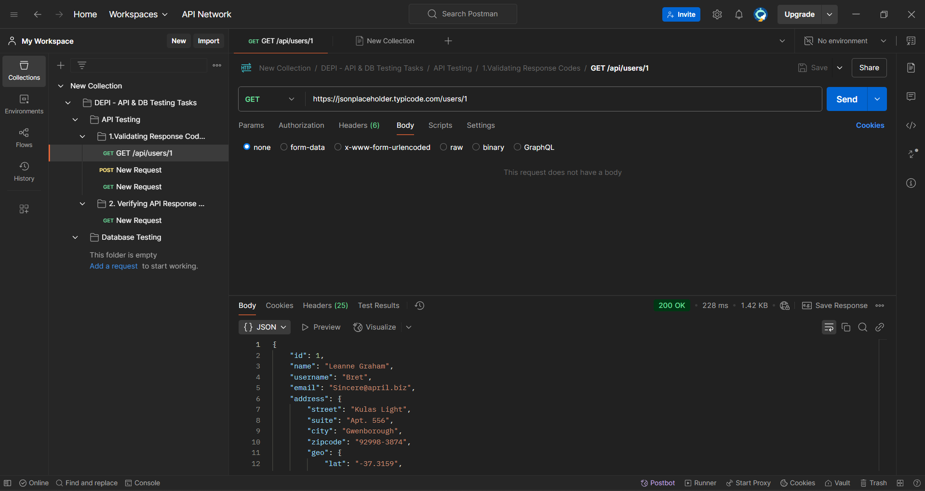
API Testing – Validating Response Codes

Slide 20
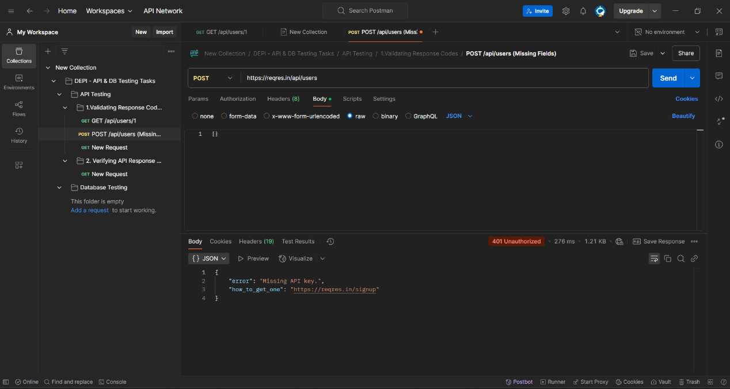

Slide 21
Database Testing Using(DB Fiddle)
Actual Result | Expected Result | Test Case | SQL Operation
✅ Success | ✅ Record inserted | Add user | INSERT
✅ Data matched | ✅ Returns user data | Fetch by email | SELECT
✅ Name updated | ✅ Name updated | Change name | UPDATE
✅ No data found | ✅ Record removed | Remove by email | DELETE

Slide 22
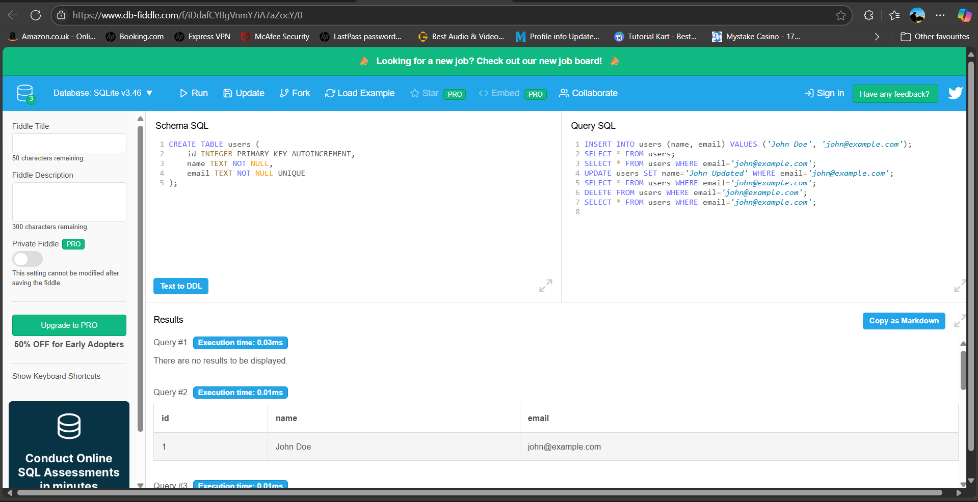

Slide 23
jmeter
Report link
https://share.note.sx/5dcs6aot#rM04gX9fJ7Yv92beNpuKO606uKJB1AvWusTkPXC6b/Q

Slide 24
Github
Used GitHub Desktop to manage code changes easily
Pushed Code to a shared GitHub repository
Link: https://github.com/Lamis10/DEPI_FinalProject

Slide 25
Roles distribution
Hana , Mai : signup , login , about us page , contact us page
Lamis , Ahmed : home page , filtering , categories section
Seif : cart page and payments

Slide 26
Thank you

